Slide 1
Image Acquisition
Lecture-2 (19th August 2021)

Slide 2
Topics covered till now:
What is Digital Image Processing?
Common image formats
Stages in Image Processing

Slide 3
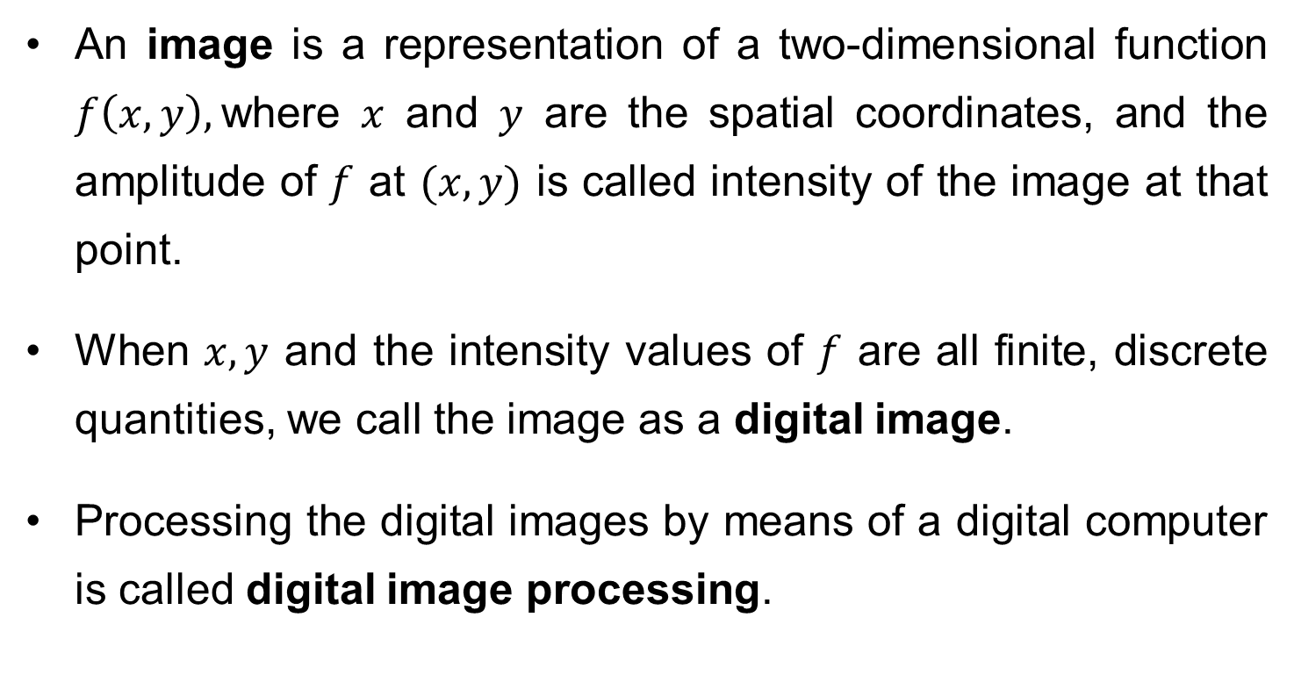
What is a Digital Image?
An image is a representation of a two-dimensional function $f\left(x,y\right),$where $x$ and $y$ are the spatial coordinates, and the amplitude of $f$ at $(x,y)$ is called intensity of the image at that point.
When $x, y$ and the intensity values of $f$ are all finite, discrete quantities, we call the image as a digital image.
Processing the digital images by means of a digital computer is called digital image processing.

Slide 4
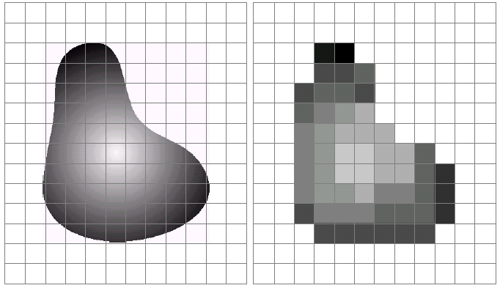
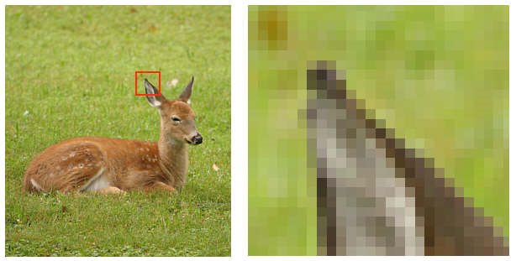
cont…
A digital image is composed of finite number of elements, each having location and value. These elements are called pixels/picture elements.
1 pixel

Slide 5
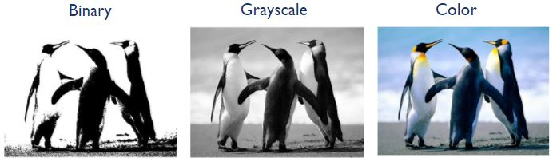
cont…
Common image formats include:
1 sample per point (B&W/binary, Grayscale)
3 samples per point (Red, Green, and Blue)

Slide 6
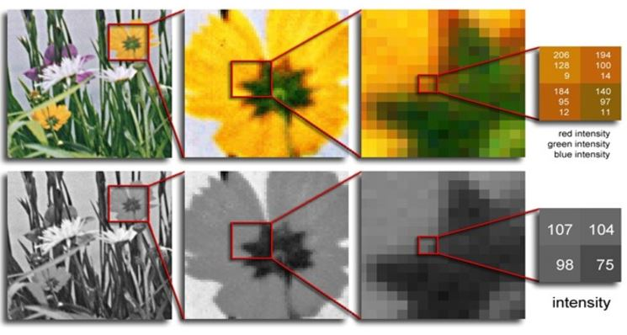
cont…

Slide 7
Key Stages in Digital Image Processing
Image Restoration
Morphological Processing
Image Enhancement
Segmentation
Image Acquisition
Representation & Description
Object Recognition
Problem Domain
Colour Image Processing
Image Compression

Slide 8
Today’s lecture
Image Acquisition Process
Image sampling and quantization
Basic relationship between pixels
Neighbors
Connectivity
Path
Region & Adjacency
Boundary
Distance Measure

Slide 9
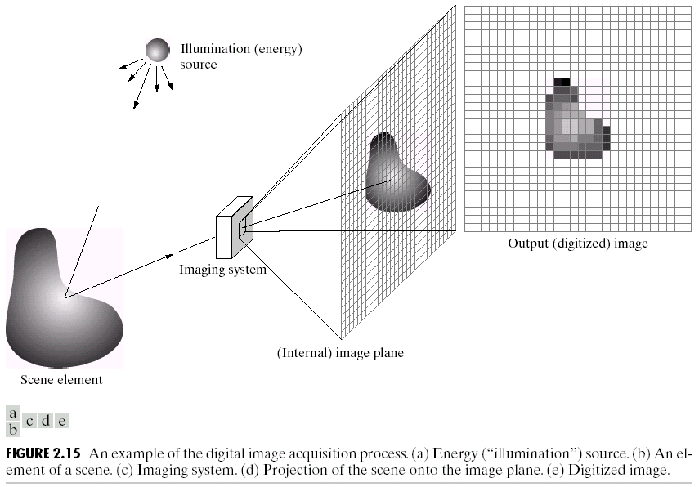
Image Acquisition Process
View at lens focal plane

Slide 10
Why digitization??
A continuous image is represented by infinite number of points.
Each point may have one of the infinitely many possible intensity value. This will need infinite number of bits to represent the color.
Therefore, such representation is not possible in any digital computer.

Slide 11
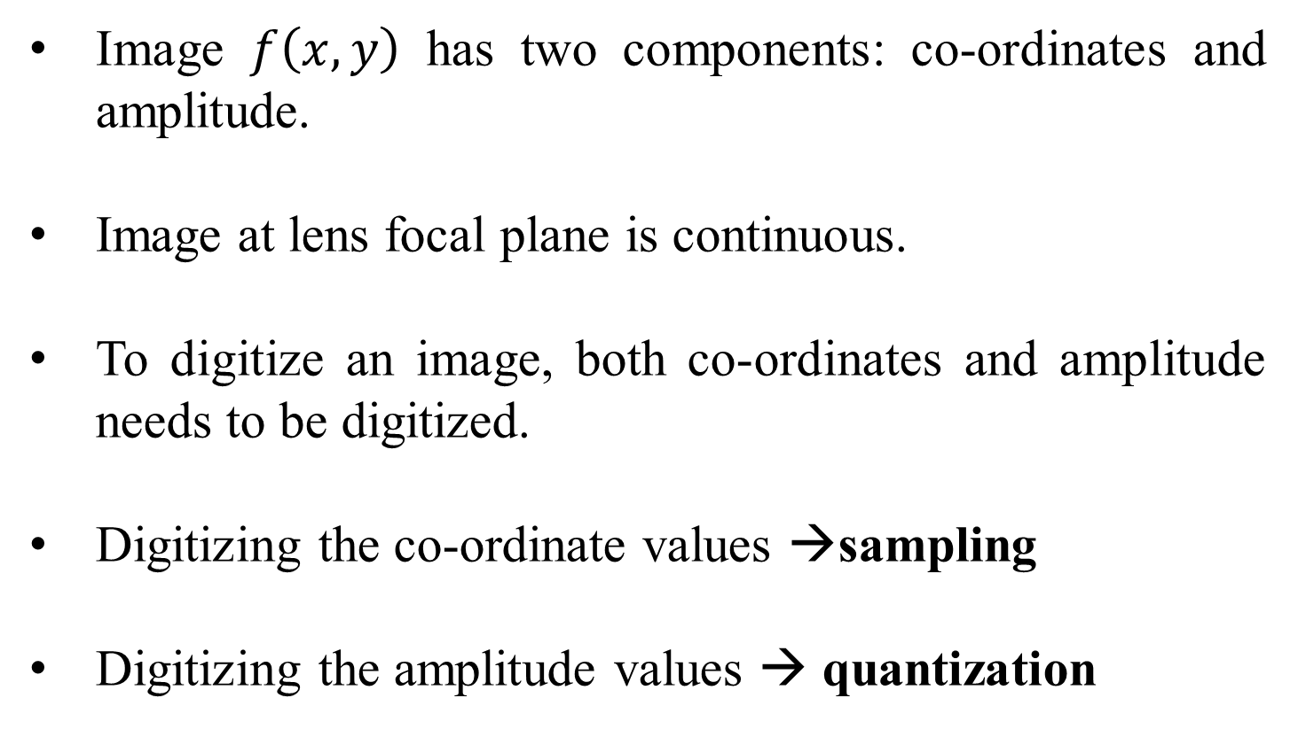
Image Sampling and Quantization
Image $f\left(x,y\right)$ has two components: co-ordinates and amplitude.
Image at lens focal plane is continuous.
To digitize an image, both co-ordinates and amplitude needs to be digitized.
Digitizing the co-ordinate values →sampling
Digitizing the amplitude values → quantization

Slide 12
Sampling
The co-ordinate values of a continuous image is digitized as a 2-D matrix.
where M → finite rows and N→ finite columns

Slide 13
Quantization
Intensity → digitized
Quantization levels/gray levels (L)
How many quantization levels can we have?

Slide 14
How many quantization levels can we have?
Quantization levels→ [0, L-1]
L=2^{k}
k →no. of bits per channel

Slide 15
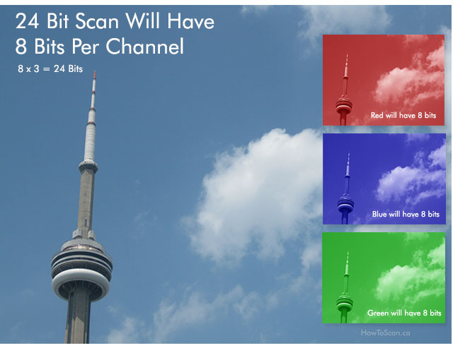
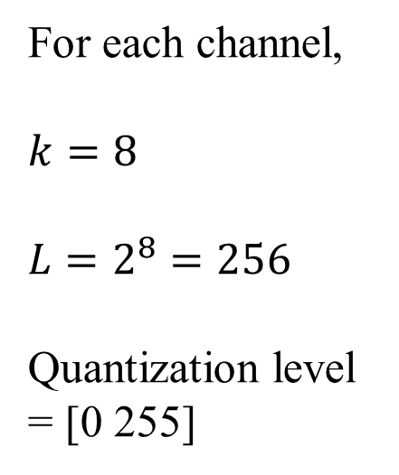
Example
For each channel,
$$k=8$$
$$L=2^{8}=256$$
Quantization level = [0 255]

Slide 16
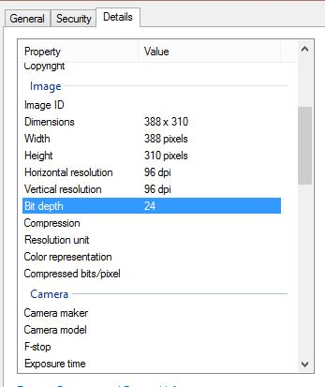

Slide 17
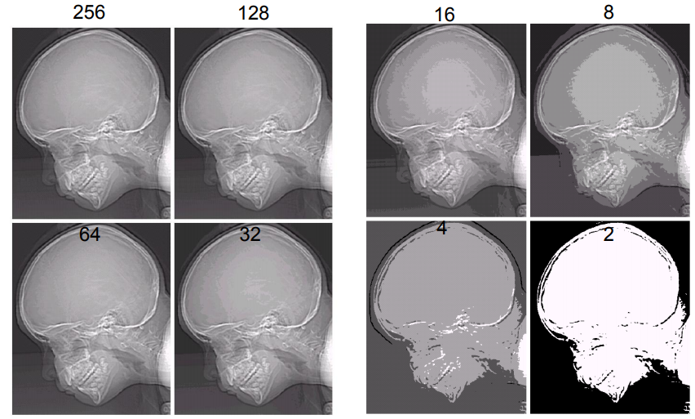
Images with varying intensity levels ‘L’

Slide 18
The number ‘b’ of bits required to store a M × N digitized image
b = M × N × k
k representing k bit image

Slide 19
Digital Computer
Sampling
Quantization
Digital Computer
D to A Converter
Display

Slide 20
Basic relationships between pixels
Neighborhood
Connectivity
Adjacency
Paths
Regions and boundaries

Slide 21
Neighborhood
Neighbors of a pixel p at coordinates (x,y)
4-neighbors of p, denoted by N₄(p):
(x-1, y), (x+1, y), (x,y-1), and (x, y+1).
4 diagonal neighbors of p, denoted by N_{D}(p):
(x-1, y-1), (x+1, y+1), (x+1,y-1), and (x-1, y+1).
8 neighbors of p, denoted N₈(p)
N₈(p) = N₄(p) U N_{D}(p)

Slide 22
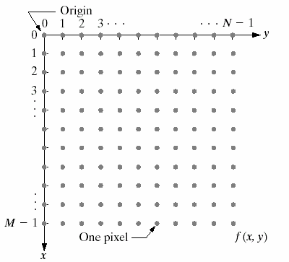

$$(x,y)$$

Slide 23
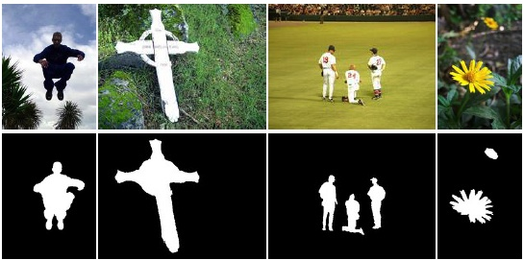
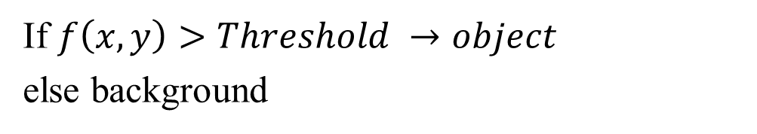
Connectivity
If $f\left(x,y\right)>Threshold →object$
else background
Obj 1
Obj 2

Slide 24
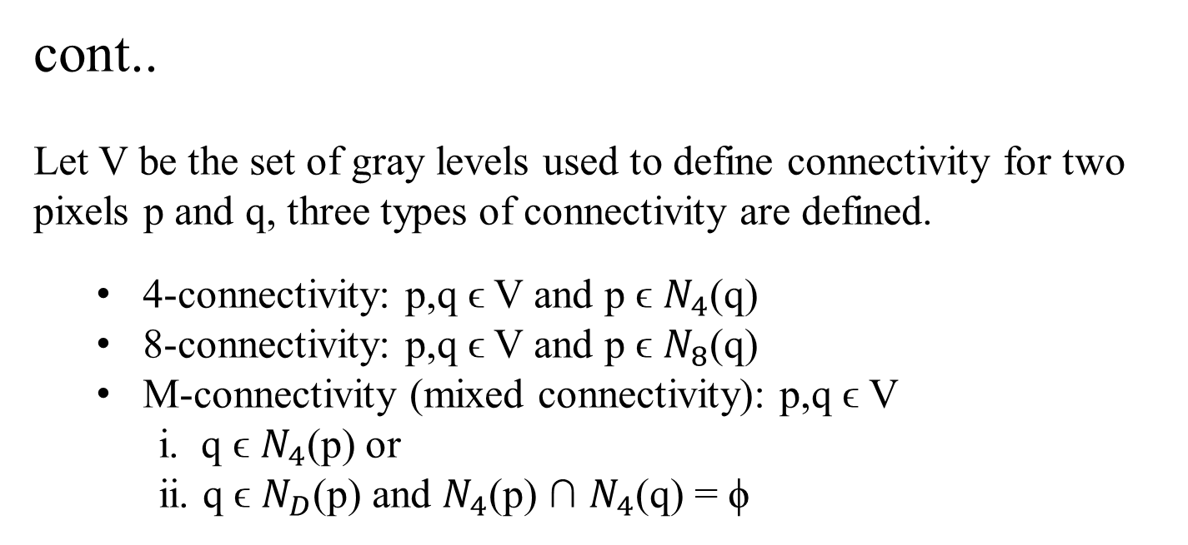
cont..
Let V be the set of gray levels used to define connectivity for two pixels p and q, three types of connectivity are defined.
4-connectivity: p,q ϵ V and p ϵ $N_{4}$(q)
8-connectivity: p,q ϵ V and p ϵ $N_{8}$(q)
M-connectivity (mixed connectivity): p,q ϵ V
i. q ϵ $N_{4}$(p) or
ii. q ϵ $N_{D}$(p) and $N_{4}$(p) ∩ $N_{4}$(q) = ϕ
Eg. V={1}
0 | 1 | 1
0 | 1 | 0
0 | 0 | 1
0 | 1 | 1
0 | 1 | 0
0 | 0 | 1
0 | 1 | 1
0 | 1 | 0
0 | 0 | 1
q
p
4-connectivity
8-connectivity
M-connectivity

Slide 25
M-connectivity avoids multi path connections that often arise with 8-connectivity.

Slide 26
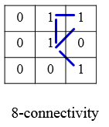
Path
A (digital) path (or curve) from pixel p with coordinates (x₀, y₀) to pixel q with coordinates (x_{n}, y_{n}) is a sequence of distinct pixels with coordinates
(x₀, y₀), (x₁, y₁), …, (x_{n}, y_{n})
where (x_{i}, y_{i}) and (x_{i-1}, y_{i-1}) are adjacent for 1 ≤ i ≤ n.
Here n is the length of the path.
If (x₀, y₀) = (x_{n}, y_{n}), the path is closed path.
We can define 4-, 8-, and m-paths based on the type of adjacency used.
p
q

Slide 27
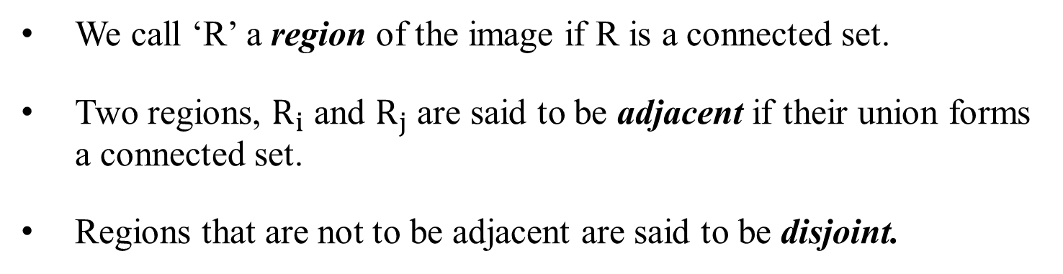
Region & Adjacency
We call ‘R’ a region of the image if R is a connected set.
Two regions, $R_{i}$ and $R_{j}$ are said to be adjacent if their union forms a connected set.
Regions that are not to be adjacent are said to be disjoint.
1 | 1 | 1
1 | 0 | 1
0 | 1 | 0
0 | 0 | 1
1 | 1 | 1
1 | 1 | 1
Region 1
8-adjacency
4-adjacency
8-adjacency
m-adjacency
Region 2

Slide 28
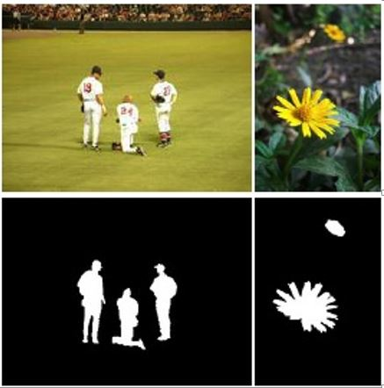
disjoint
Object 2
Object 3
Black- background
White- foreground
Object 1
Object 2
Object 1
Once connected regions are obtained, many properties of those regions can be obtained such as boundary, area, etc.

Slide 29
Boundary
The boundary of the region R is the set of pixels in the region that have one or more neighbors that are not in R (background).
0 | 1 | 0 | 0 | 0
1 | 1 | 1 | 0 | 0
0 | 1 | 1 | 1 | 0
0 | 1 | 1 | 1 | 1
1 | 1 | 1 | 1 | 0
0 | 1 | 0 | 0 | 0
Black- background
White- foreground
8 - connectivity

Slide 30
0 | 1 | 0 | 0 | 0
1 | 1 | 1 | 0 | 0
0 | 1 | 1 | 1 | 0
0 | 1 | 1 | 1 | 1
1 | 1 | 1 | 1 | 0
0 | 1 | 0 | 0 | 0
Black- background
White- foreground
8 - connectivity
4 - connectivity
MATLAB: B = bwboundaries (binary_image,connectivity)

Slide 31
Distance Measures
Given pixels p, q and z with coordinates (x, y), (s, t), (u, v) respectively, the distance function D has following properties:
D(p, q) ≥ 0 [D(p, q) = 0, iff p = q]
D(p, q) = D(q, p)
D(p, z) ≤ D(p, q) + D(q, z)

Slide 32
Euclidean Distance
The Euclidean Distance between p and q is defined as:
D_{e} (p,q) = [(x – s)² + (y - t)²]^{1/2}
D_{e} (p,q)
q (s,t)
p (x,y)

Slide 33
City-Block Distance
The D₄ distance (also called city-block distance) between p and q is defined as:
D₄ (p,q) = | x – s | + | y – t |
q (s,t)
D₄
p (x,y)

Slide 34
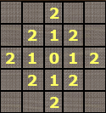
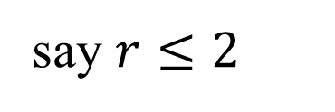
Pixels having a D₄ distance from (x,y), less than or equal to some value r form a Diamond centered at (x,y).
say $r≤2$
(x,y)

Slide 35
Chessboard Distance
The D₈ distance (also called chessboard distance) between p and q is defined as:
D₈ (p,q) = max(| x – s |,| y – t |)
q (s,t)
D_{8(b)}
p (x,y)
D_{8(a)}
D₈ = max(D_{8(a) ,} D_{8(b)})

Slide 36
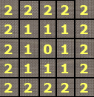
Pixels having a D₈ distance from (x,y), less than or equal to some value r form a square centered at (x,y).
say $r≤2$
(x,y)

Slide 37
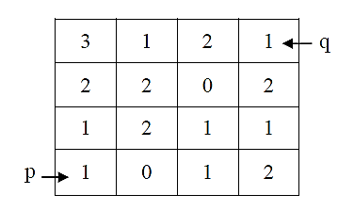
Q.
Let V={0, 1}. Compute the lengths of the shortest 4-path, 8-path and m-path between ‘p’ and ‘q’ shown in figure below. Also show the path formed. What is the value of Chessboard distance and City block distance

Slide 38
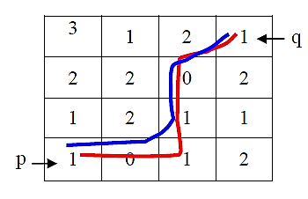
Ans:
When V={0, 1}, 4-path does not exist.
The shortest 8-path has length = 4 (as shown in blue line) and the shortest m-path has length = 5 (as shown in red line).
Chessboard distance : 3
City block distance : 6

